Slide 1
Idea del ACP con Kernel

Slide 2
Easy to apply PCA on this data
Before PCA
After PCA
IV2
IV2
PC1
PC2
PCA
IV1
IV1
PC1 and PC2 are the directions of maximum variance
Notes:
Transition from this slide to the next one: How did K-Means do that ? Let's see how it did it step by step. I will first give you the whole algorithm, and then we will see each step of the algorithm on a simple example.

Slide 3
What about on this data ?
Before PCA
After PCA ?
IV2
IV2
PC1
PC2
PCA
IV1
IV1
Are PC1 and PC2 the directions of maximum variance ?
Notes:
Transition from this slide to the next one: How did K-Means do that ? Let's see how it did it step by step. I will first give you the whole algorithm, and then we will see each step of the algorithm on a simple example.

Slide 4
What about on this data ?
Before PCA
After PCA ?
IV2
IV2
PC2
PCA
PC1
IV1
IV1
Are PC1 and PC2 the directions of maximum variance ?
Notes:
Transition from this slide to the next one: How did K-Means do that ? Let's see how it did it step by step. I will first give you the whole algorithm, and then we will see each step of the algorithm on a simple example.

Slide 5
What about on this data ?
Before PCA
After PCA ?
IV2
IV2
PC2
PCA
PC1
IV1
IV1
Are PC1 and PC2 the directions of maximum variance ?
Notes:
Transition from this slide to the next one: How did K-Means do that ? Let's see how it did it step by step. I will first give you the whole algorithm, and then we will see each step of the algorithm on a simple example.

Slide 6
What about on this data ?
Before PCA
After PCA ?
IV2
IV2
?
PCA
IV1
IV1
We have trouble finding some good directions of maximum variance
Notes:
Transition from this slide to the next one: How did K-Means do that ? Let's see how it did it step by step. I will first give you the whole algorithm, and then we will see each step of the algorithm on a simple example.

Slide 7
Why ?
Because the data points are not LINEARLY SEPARABLE

Slide 8
Why ?
PCA works well when the data is LINEARLY SEPARABLE

Slide 9
Linear Separability
Linearly Separable
Not Linearly Separable
x2
x2
x1
x1
Notes:
Mapping to a Higher Dimensional Space in which the data is Linearly Separable

Slide 10
Solution ?
Solution when the data is not LINEARLY SEPARABLE ?

Slide 11
Solution
KERNEL PCA

Slide 12
A Higher-Dimensional Space

Slide 13
Mapping to a Higher Dimension
f = x - 5
0
x1

Slide 14
Mapping to a Higher Dimension
f = x - 5
f = (x – 5)^2
0
x1

Slide 15
Mapping to a Higher Dimension
f = x - 5
f = (x – 5)^2
0
x1

Slide 16
Mapping to a Higher Dimension
2D Space
x2
x1

Slide 17
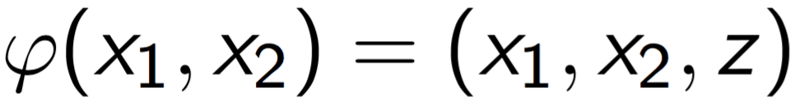
Mapping to a Higher Dimension
2D Space
x2
Mapping Function
x1
Notes:
We apply the Mapping Function...

Slide 18
Mapping to a Higher Dimension
z
3D Space
2D Space
x2
Mapping Function
x2
x1
x1
Notes:
... to transform the data points into Higher Dimensional Space.

Slide 19
Mapping to a Higher Dimension
New Dimension
z
3D Space
2D Space
x2
Hyperplane
Mapping Function
x2
x1
x1

Slide 20
Solution
Now that the data is Linearly Separable in this 3D Space, we can apply PCA inside this 3D Space.

Slide 21
Solution
And we don’t have to project back into 2D Space like for Kernel SVM,
by nature of PCA that will itself take care of reducing dimensionality.

Slide 22
But there is a catch...
Mapping to a Higher Dimensional Space can be highly compute-intensive

Slide 23
The Kernel Trick
Notes:
landmarks

Slide 24
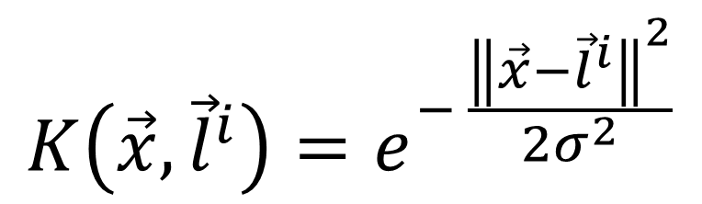
The Gaussian RBF Kernel
Notes:
Just give this Kernel as an example and say that this is the most popular Kernel and this is the one we are going to use in the R & Python applications.
Maybe precise that x^i and x^j are some data points and not coordinates.
https://www.youtube.com/watch?v=HwQQXs4Nyjo
https://www.youtube.com/watch?v=LHzqW0EolzE
https://www.youtube.com/watch?v=OmTu0fqUsQk

Slide 25
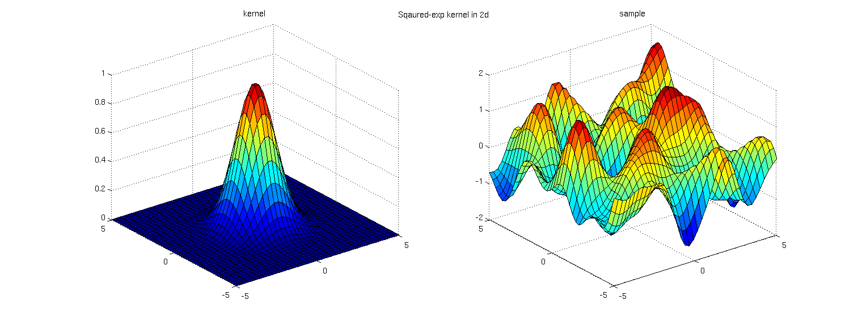
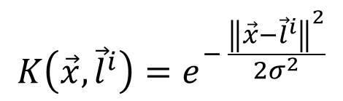
The Gaussian RBF Kernel
Image source: http://www.cs.toronto.edu/~duvenaud/cookbook/index.html
Notes:
Just give this Kernel as an example and say that this is the most popular Kernel and this is the one we are going to use in the R & Python applications.
Maybe precise that x^i and x^j are some data points and not coordinates.
https://www.youtube.com/watch?v=HwQQXs4Nyjo
https://www.youtube.com/watch?v=LHzqW0EolzE
https://www.youtube.com/watch?v=OmTu0fqUsQk

Slide 26
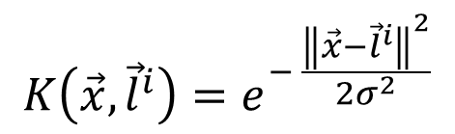
The Gaussian RBF Kernel
2D Space
x2
Landmark
x1
Notes:
Just give this Kernel as an example and say that this is the most popular Kernel and this is the one we are going to use in the R & Python applications.
Maybe precise that x^i and x^j are some data points and not coordinates.
https://www.youtube.com/watch?v=HwQQXs4Nyjo
https://www.youtube.com/watch?v=LHzqW0EolzE
https://www.youtube.com/watch?v=OmTu0fqUsQk

Slide 27

The Gaussian RBF Kernel
2D Space
x2
x1
Notes:
Just give this Kernel as an example and say that this is the most popular Kernel and this is the one we are going to use in the R & Python applications.
Maybe precise that x^i and x^j are some data points and not coordinates.
https://www.youtube.com/watch?v=HwQQXs4Nyjo
https://www.youtube.com/watch?v=LHzqW0EolzE
https://www.youtube.com/watch?v=OmTu0fqUsQk

Slide 28
The Gaussian RBF Kernel
2D Space
x2
x1
Notes:
Just give this Kernel as an example and say that this is the most popular Kernel and this is the one we are going to use in the R & Python applications.
Maybe precise that x^i and x^j are some data points and not coordinates.
https://www.youtube.com/watch?v=HwQQXs4Nyjo
https://www.youtube.com/watch?v=LHzqW0EolzE
https://www.youtube.com/watch?v=OmTu0fqUsQk

Slide 29

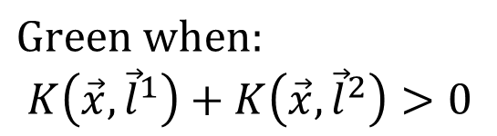
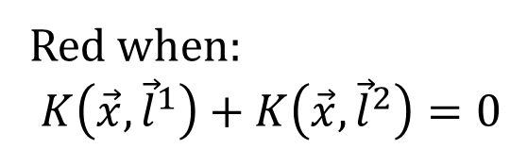
The Gaussian RBF Kernel
x2
(Simplified Formula)
x1
Notes:
Just give this Kernel as an example and say that this is the most popular Kernel and this is the one we are going to use in the R & Python applications.
Maybe precise that x^i and x^j are some data points and not coordinates.
https://www.youtube.com/watch?v=HwQQXs4Nyjo
https://www.youtube.com/watch?v=LHzqW0EolzE
https://www.youtube.com/watch?v=OmTu0fqUsQk

Slide 30
Types of Kernel Functions
Notes:
landmarks

Slide 31
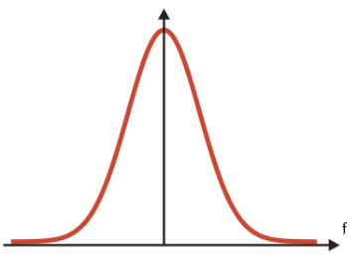
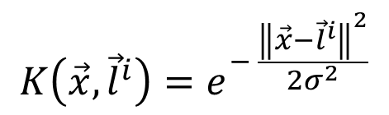
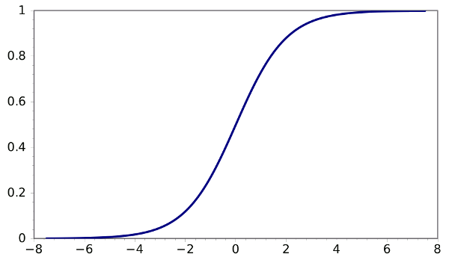

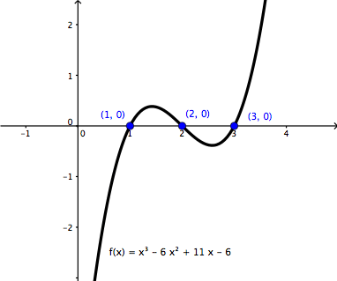

Types of Kernel Functions
Gaussian RBF Kernel
Sigmoid Kernel
Polynomial Kernel
Notes:
The final thing you need to know is that the RBF is not the only Kernel function used in Kernel SVM.

